Slide 1
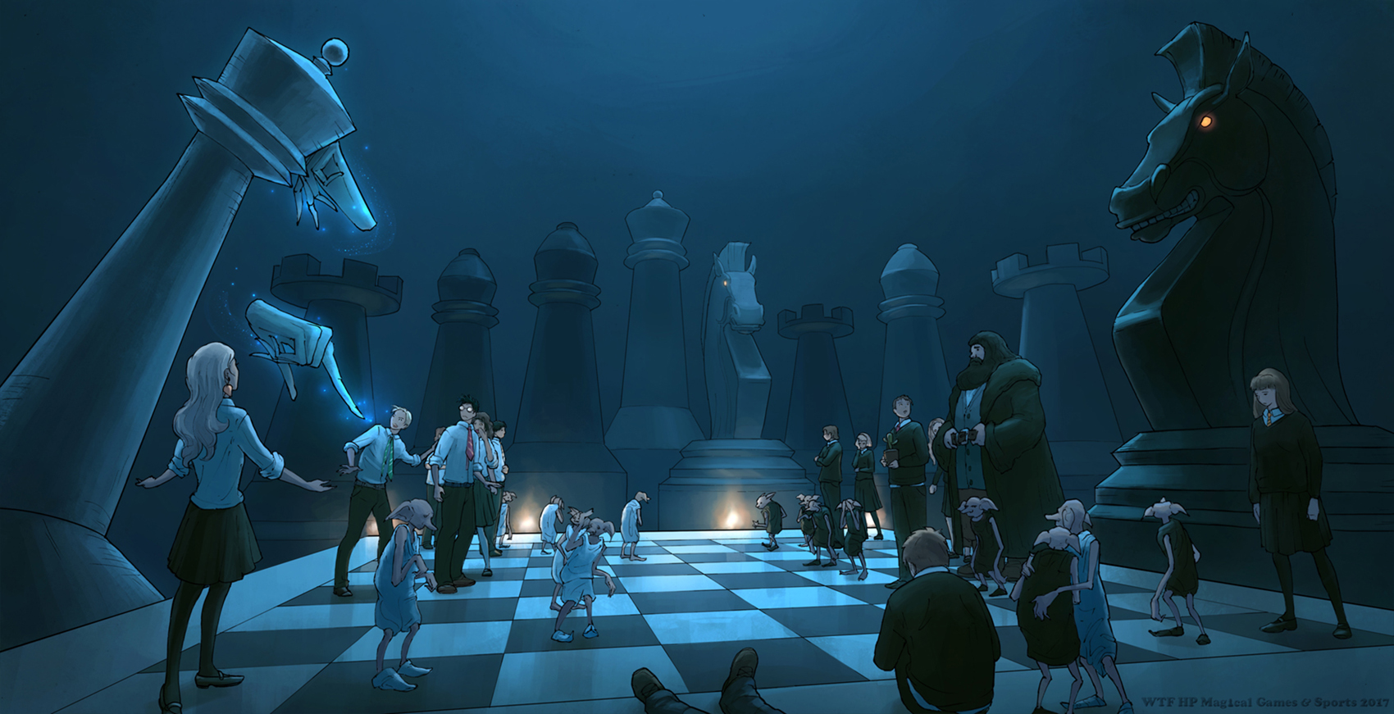
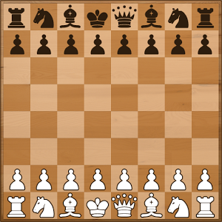
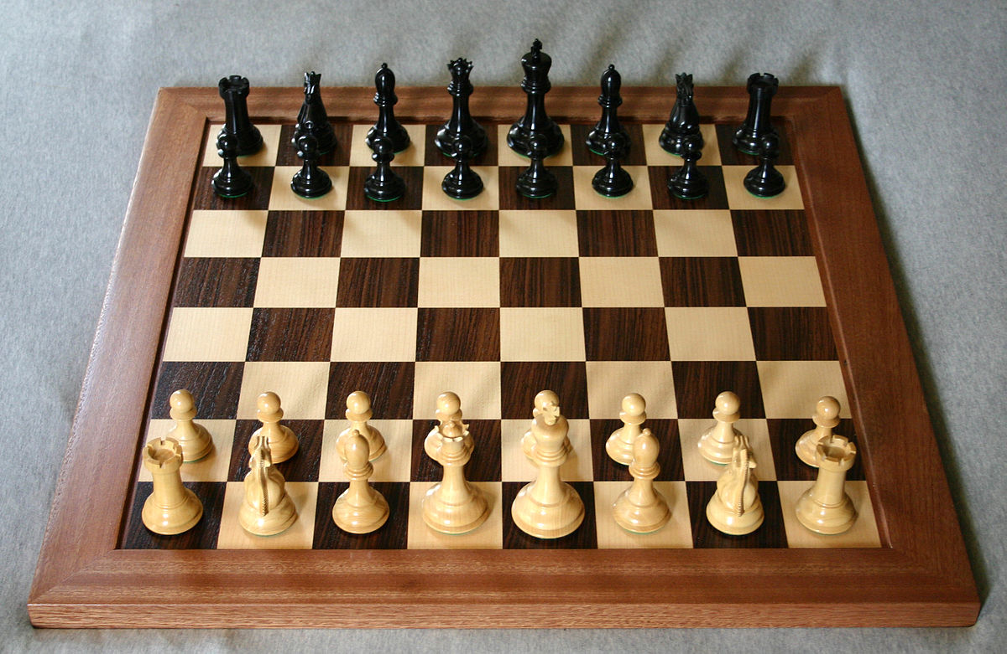






Visual Chess Recognition
CHESSBOARD
CHESS PIECES
TWO SUB PATTERN-RECOGNITION PROBLEMS
LE Ha Quang – X2015

Slide 2
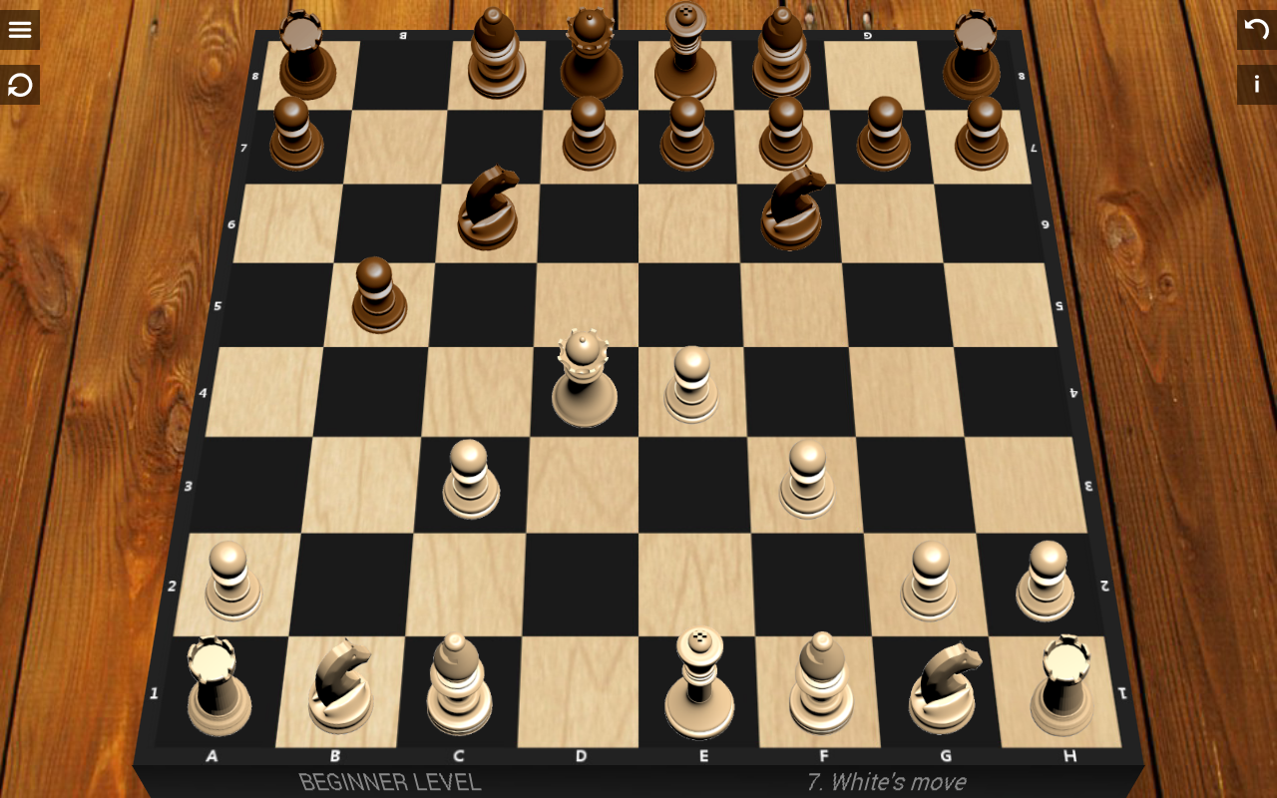
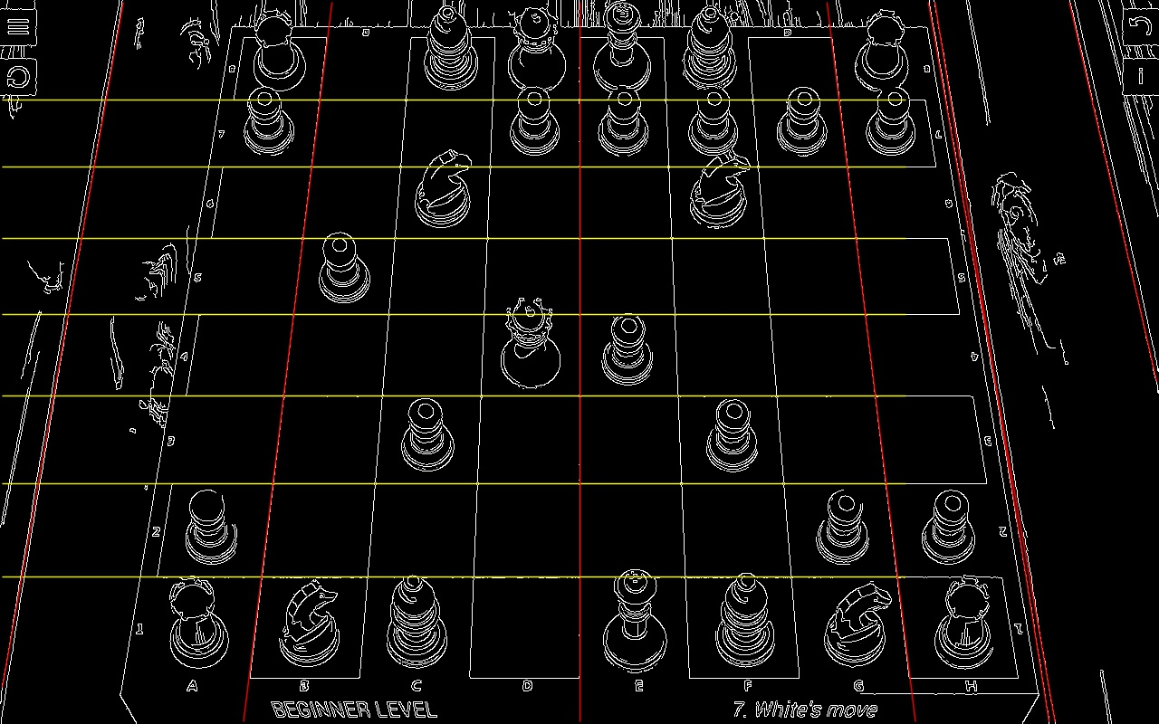
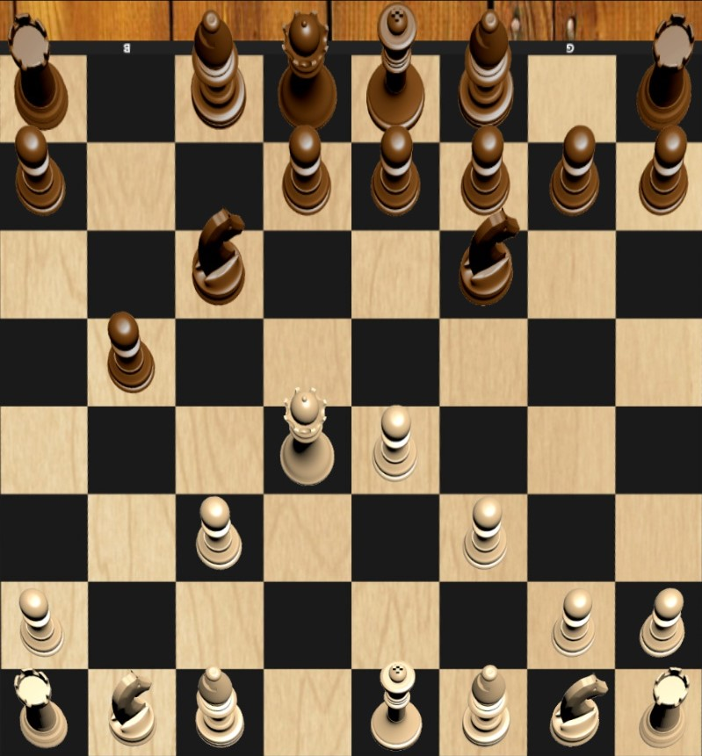
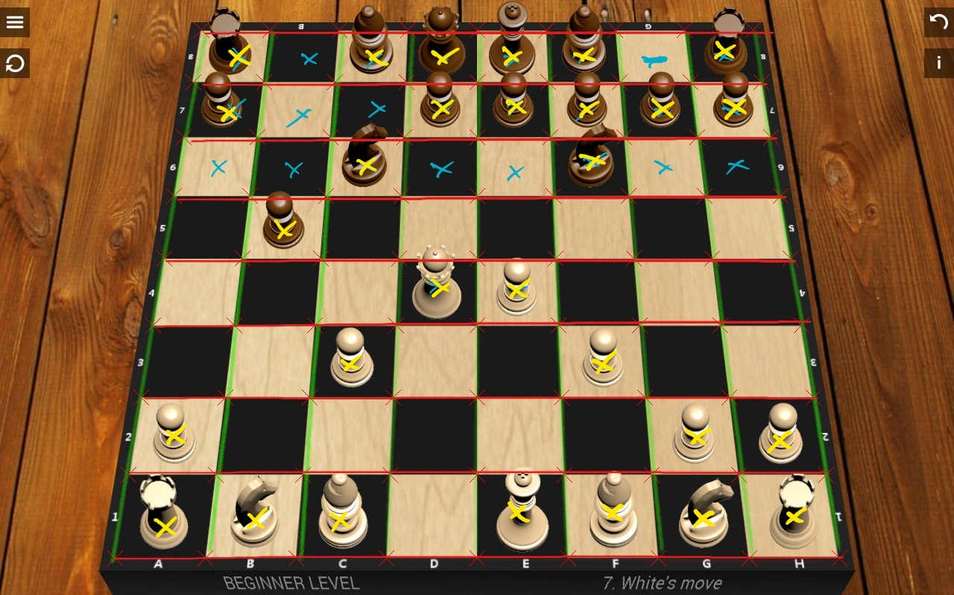





Chessboard Recognition
Canny Detector + HoughLine
Compute Homography
Take Inversed

Slide 3
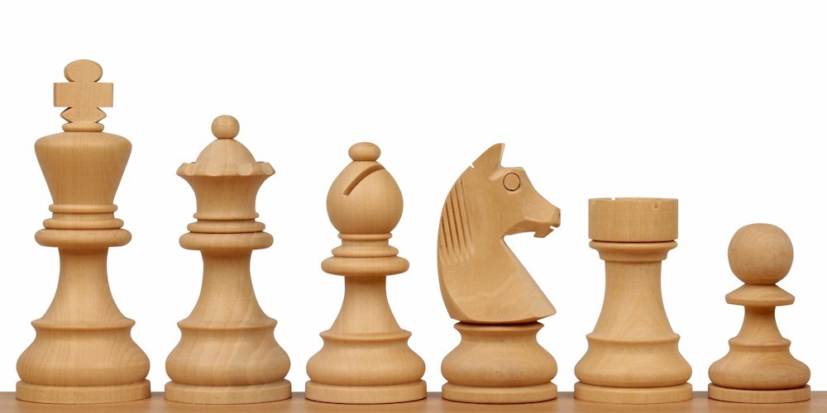
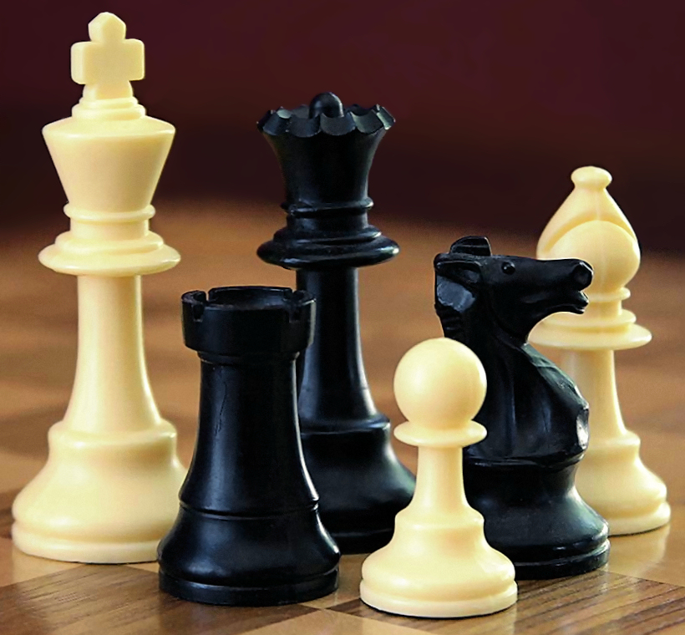


Piece Recognition
Ideas:
Neural Network for Pattern Recognition
Calculate similarity directly using (for ex. Fourier) descriptors
Challenges:
Lack of fiable large dataset
Hardly piece-detached images

